Slide 1
About Me
Ritesh Singh
Sun Certified java Professional
Oracle Certified Database Administrator
Certified Ethical Hacker
Certified EC-Council Instructor (CEI)

Slide 2
Course Overview
Connect to MySQL Server
Connect to MySQL Using mysql command-line client
Connect to MySQL Using MySQL Workbench

Slide 3
Connect to MySQL Using mysql command-line client
mysql is a command-line client program that allows you to interact with MySQL in the interactive and non-interactive mode.
The mysql command-line client is typically located in the bin directory of the MySQL’s installation folder.
To invoke the mysql program, you just simply navigate to the bin directory of the MySQL’s installation folder and type:
mysql
If the mysql program is already in the PATH, you can simply invoke it using mysql command.

Slide 4
To connect to the MySQL Server, you use this command:
shell>mysql -u root -p
-u root means that you connect to the MySQL Server using the user account root.
-p instructs mysql to prompt for a password.
You type the password for the user account root and press Enter:
Enter password: ********
If everything is OK, you will connect to the MySQL Server with the following command:
mysql>

Slide 5
To display the databases in the current server, you use the SHOW DATABASES statement:
mysql> show databases;
Here is the output:
+--------------------+
| Database |
+--------------------+
| information_schema |
| mysql |
| performance_schema |
| sys |
+--------------------+
4 rows in set (0.01 sec)

Slide 6
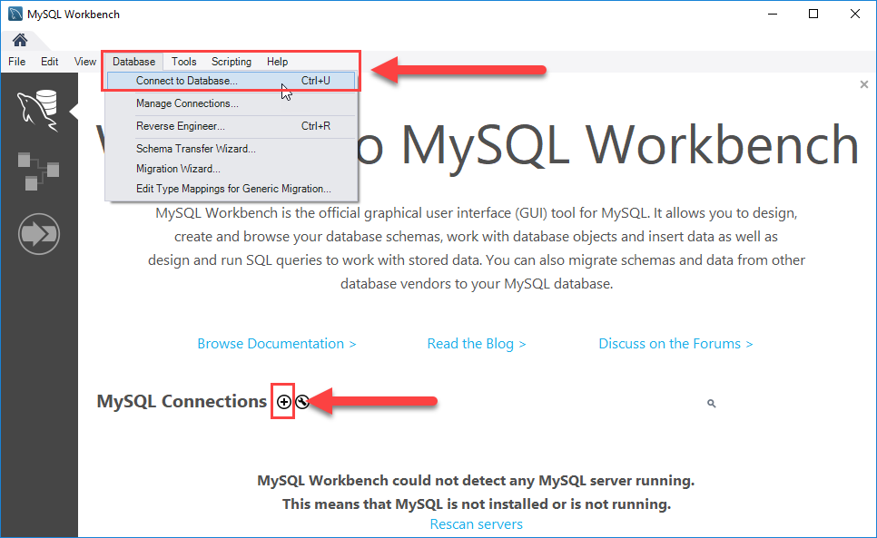
Connect to MySQL Using MySQL Workbench
Step 1. Launch the MySQL Workbench.

Slide 7
You can connect to a MySQL Server using the Database > Connect to Database… menu or click the + button that locates next to the MySQL Connections.
Just click the + button in next to the MySQL Connections to continue.
Step 2. Enter the connection name e.g., Localhost. You can name it whatever makes sense to you. By default, the username is root. If you use a different user account, you can change it in the Username textbox.

Slide 8
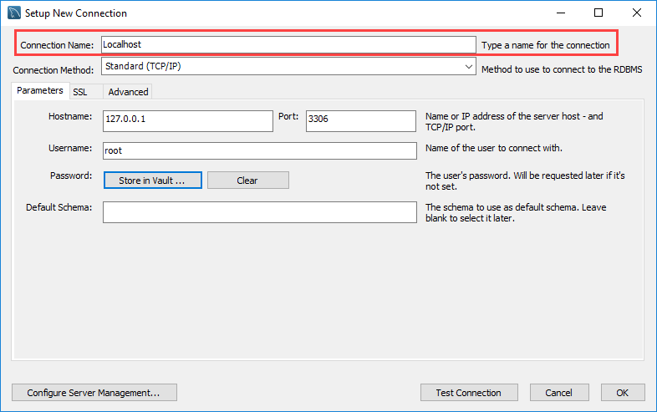

Slide 9
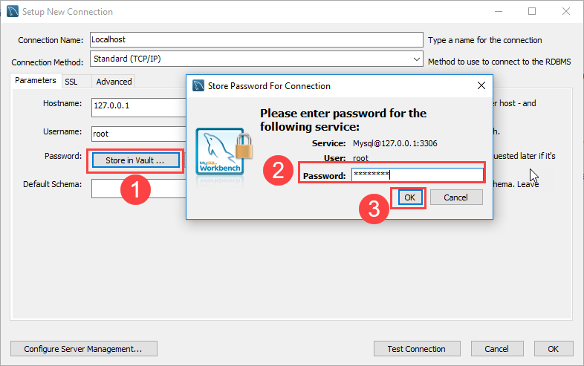
Step 3. Click the Store in Vault ... button to enter the password for the provided user account. A window will display. You enter the password and click the OK button.

Slide 10
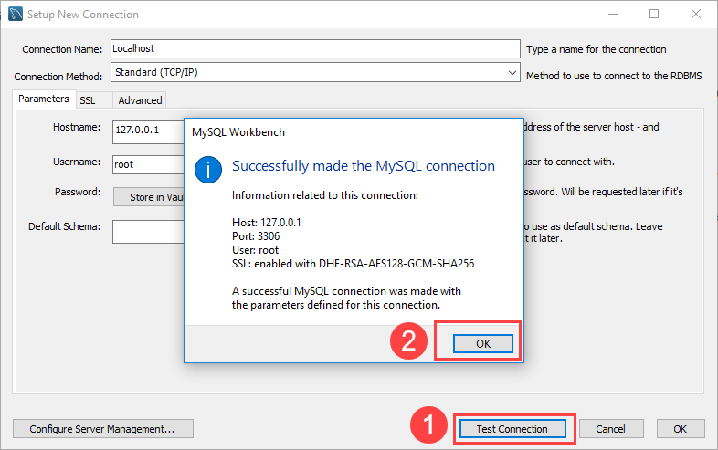
Step 4. Click the Test Connection button to test if the connection to the MySQL Server is successful or not. Then click the OK button if the connection is established successfully.

Slide 11
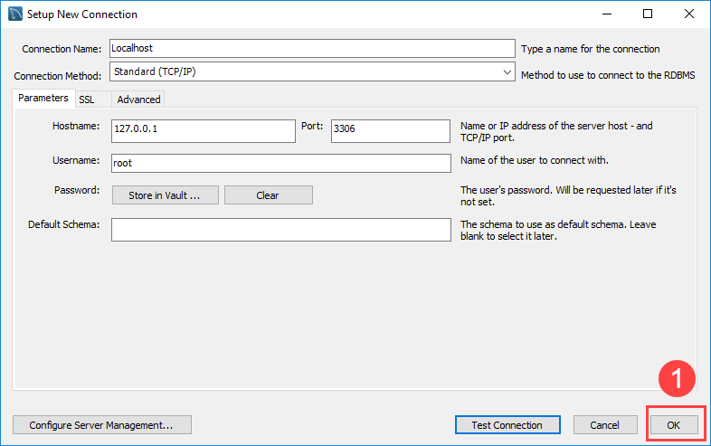
Step 5. Click the OK button to save the connection.

Slide 12
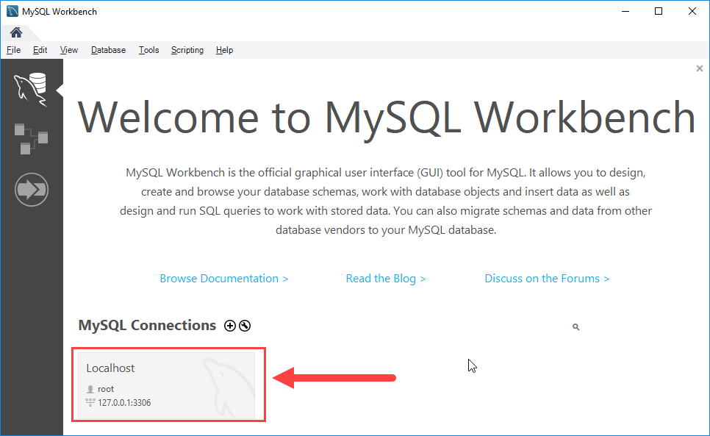
Step 6. Click the newly created connection under MySQL Connections to connect to the MySQL Server:

Slide 13
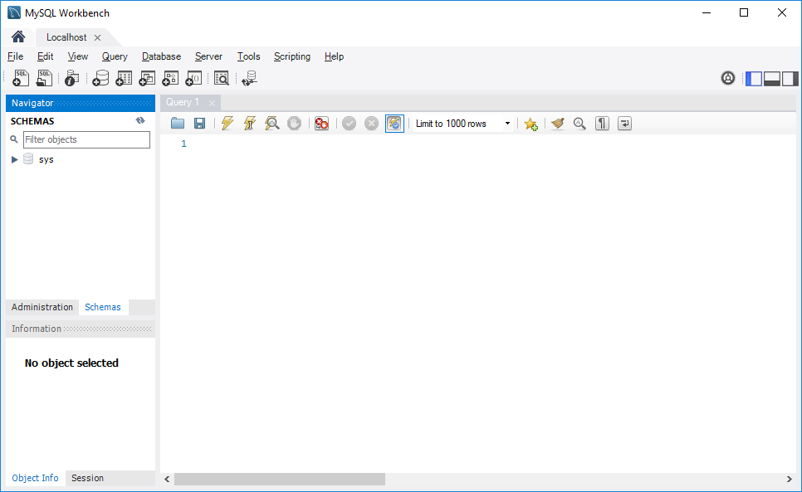
Step 7. MySQL Workbench display with the current schemas and a pane for entering queries

Slide 14
Thank You
Please Subscribe My Channel
https://www.youtube.com/channel/UCYW3PWPOPn3qgxxjhUbXXXg?view_as=subscriber

